Slide 1
Tasks and Functions
Learning Objectives
Describe the differences between tasks and functions
Identify the conditions required for tasks to be defined
Understand task declaration and invocation
Explain the conditions necessary for functions to be defined
Understand function declaration and invocation

Slide 2
A designer is frequently required to implement the same functionality at many places in a behavioral design
This means that the commonly used parts should be abstracted into routines and the routines must be invoked instead of repeating the code
Most programming languages provide procedures or subroutines to accomplish this
Verilog provides tasks and functions to break up large behavioral designs into smaller pieces.
Tasks and functions allow the designer to abstract Verilog code that is used at many places in the design.
Tasks have input, output, and inout arguments
functions have input arguments
Thus,values can be passed into and out from tasks and functions
Tasks and functions are included in the design hierarchy. Like named blocks, tasks or functions can be addressed by means of hierarchical names

Slide 3
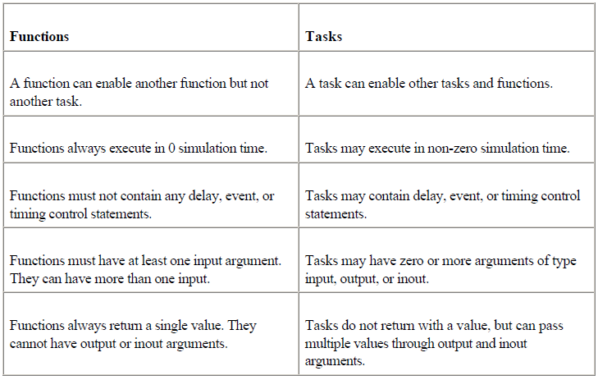
Differences between Tasks and Functions

Slide 4
Differences between Tasks and Functions –Cont’d
Both tasks and functions must be defined in a module and are local to the module
Tasks are used for common Verilog code that contains delays, timing, event constructs, or multiple output arguments
Functions are used when common Verilog code is purely combinational, executes in zero simulation time, and provides exactly one output
Functions are typically used for conversions and commonly used calculations
Tasks can have input, output, and inout arguments

Slide 5
Differences between Tasks and Functions –Cont’d
functions can have input arguments. In addition, they can have local variables, registers, time variables, integers, real, or events
Tasks or functions cannot have wires
Tasks and functions contain behavioral statements only.
Tasks and functions do not contain always or initial statements but are called from always blocks, initial blocks, or other tasks and functions

Slide 6
Tasks are declared with the keywords task and endtask
Tasks must be used if any one of the following conditions is true for the procedure:
There are delay, timing, or event control constructs in the procedure
The procedure has zero or more than one output arguments
The procedure has no input arguments

Slide 7
Functions
Functions are declared with the keywords function and endfunction
Functions are used if all of the following conditions are true for the procedure:
There are no delay, timing, or event control constructs in the procedure
The procedure returns a single value
There is at least one input argument
There are no output or inout arguments
There are no nonblocking assignments

Slide 8
Automatic (Re-entrant) Tasks
Tasks are normally static in nature
All declared items are statically allocated and they are shared across all uses of the task executing concurrently
Therefore, if a task is called concurrently from two places in the code, these task calls will operate on the same task variables
It is highly likely that the results of such an operation will be incorrect
To avoid this problem, a keyword automatic is added in front of the task keyword to make the tasks re-entrant. Such tasks are called automatic tasks

Slide 9
All items declared inside automatic tasks are allocated dynamically for each invocation
Each task call operates in an independent space. Thus, the task calls operate on independent copies of the task variables. This results in correct operation
It is recommended that automatic tasks be used if there is a chance that a task might be called concurrently from two locations in the code

Slide 10
Automatic (Recursive) Functions
Functions are normally used non-recursively
If a function is called concurrently from two locations, the results are non-deterministic because both calls operate on the same variable space
However, the keyword automatic can be used to declare a recursive (automatic) function where all function declarations are allocated dynamically for each recursive calls
Each call to an automatic function operates in an independent variable space
Automatic function items cannot be accessed by hierarchical references
Automatic functions can be invoked through the use of their hierarchical name

Slide 11
Constant Functions
A constant function is a regular Verilog HDL function, but with certain restrictions.
These functions can be used to reference complex values and can be used instead of
constants.
Signed Functions
Signed functions allow signed operations to be performed on the function return values.

